Slide 1
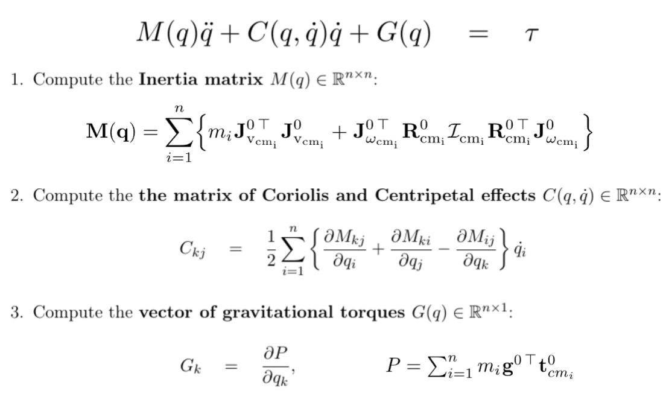

Slide 2
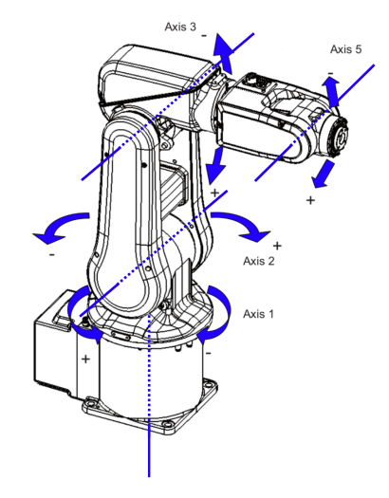











cf₃
cf₂
cf_{cm3}
cf_{ef}
cf_{cm4}
cf_{cm2}
cf₁
cf_{cm1}
cf₀

